Slide 1
INB380 Game Project Lecture 5 – User Testing
Ross Brown

Slide 2
Testing, Testing, 1, 2, 3
“Testing leads to failure, and failure leads to understanding” - Burt Rutan

Slide 3
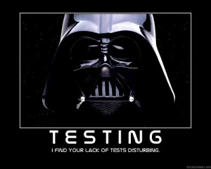
Week 5 –Testing Processes
Next four weeks to Week 9 is about testing your new beta version
From now on, you will only include components that emerge from testing commentary
eg. testers want more levels; then you can add one
Each critique now centres on how the testing went, arbitrary building is now deprecated

Slide 4
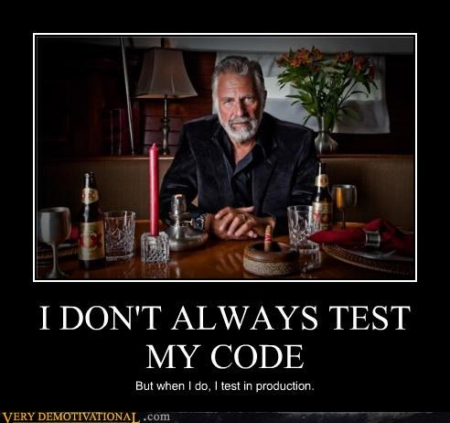
Testing Process Critiques
We expect a report from the producer regarding the testing
log changes into a testing report, same format as before
5 naïve people a week minimum – will find 80% of bugs
You have INB181 students allocated to your team – see Blackboard
If they do not respond, find other people
Ask some back as deeper testers
Please present your report wrt what happened in testing
Priority Issues discovered
Plans to fix them

Slide 5
Testing Sessions
Make sure someone in the team is managing the testing as their main task
Getting participants, making appointments, managing testing results, processing issues – it all counts
Testing sessions should utilise at least two team members
One to watch player reactions
One to watch game play on screen
Follow a script
Introduce yourselves, inform tester of their right to desist – be precise, to replicate conditions
Be cold – do not establish rapport with the tester at all, no laughing or joking, it is not meant to be fun, the GAME is meant to be fun
Offer little help, only the odd hint, maybe
Keep videos, audio files
Useful for later reference if not understanding problems
Both make COPIOUS notes!
Just record as stream of consciousness and edit later
Note everything

Slide 6
Testing Processes Testing Session Outputs
Boil down findings from testing log into a prioritised issues list
High, medium, low – look at the example documents
Track the issues - deal with game breakers first
You will not be able to fix all the bugs, so choose wisely
First report next week – get your testing started now! ☺

Slide 7
Future Weeks - Crawl, Walk, Run
This coming critique is a Crawl – show us your plans, who, what, where, how
Next week Walk - Simulated naïve playtest by Ross (David Bromley)
Week after Run with actual naïve tester in Week 7 observed by Matt and I
Show us results of playtesting: findings, surveys, what you did in response

